Slide 1
2.Regular Expressions and Automata

Slide 2
2.1 Regular Expressions
In computer science, RE is a language used for specifying text search string.
A regular expression is a formula in a special language that is used for specifying a simple class of string.
Formally, a regular expression is an algebraic notation for characterizing a set of strings.
RE search requires
  a pattern that we want to search for, and
  a corpus of texts to search through.
Regular Expressions and Automata

Slide 3
2.1 Regular Expressions
A RE search function will search through the corpus returning all texts that contain the pattern.
  In a Web search engine, they might be the entire documents or Web pages.
  In a word-processor, they might be individual words, or lines of a document. (We take this paradigm.)
    E.g., the UNIX grep command
Regular Expressions and Automata

Slide 4
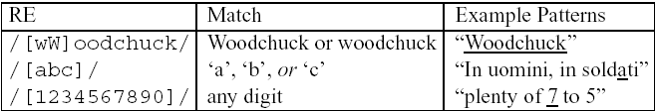
2.1 Regular Expressions
Basic Regular Expression Patterns
The use of the brackets [] to specify a disjunction of characters.
  What is the pattern to find word ‘atom’ ending with ‘m’ or ‘M’ ?
Regular Expressions and Automata

Slide 5
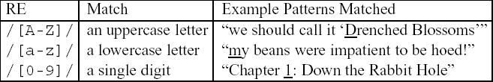
The use of the brackets [] plus the dash - to specify a range.
https://www.freeformatter.com/regex-tester.html (can try various expressions here)
Regular Expressions and Automata

Slide 6
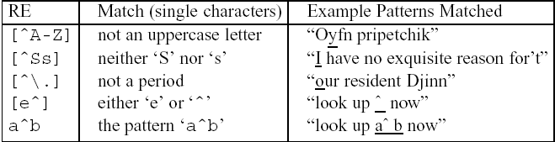
2.1 Regular Expressions
Basic Regular Expression Patterns
Uses of the caret ^ for negation or just to mean ^
Beginning-> negation
Middle->pattern matching
End->either e or ^
Regular Expressions and Automata

Slide 7

2.1 Regular Expressions
Basic Regular Expression Patterns
The question-mark ? marks optionality of the previous expression
Regular Expressions and Automata

Slide 8
2.1 Regular Expressions
Basic Regular Expression Patterns
The use of period . to specify any character
J.mp->> jump, jimp, j3mp,
J..mp->> jkkmp, jlqmp
Regular Expressions and Automata

Slide 9
2.1 Regular Expressions
Disjunction, Grouping, and Precedence
Disjunction
cat|dog
Precedence
/gupp(y|ies)/
Operator precedence hierarchy
()
* + ? { }
the ^my end$
|
Regular Expressions and Automata

Slide 10
2.1 Regular Expressions
A Simple Example
To find the English article the
/the/
Will fail for ‘The’
/[tT]he/
Will match ‘other’
/\b[tT]he\b/
Wont match ‘the_’
/[^a-zA-Z][tT]he[^a-zA-Z]/
Wont find the beginning of a line
/^|[^a-zA-Z][tT]he[^a-zA-Z]/
Either beginning of a line or nonalphabetic character
Regular Expressions and Automata

Slide 11
2.1 Regular Expressions
A More Complex Example
“any PC with more than 500 MHz and 32 Gb of disk space for less than $1000”
/$[0-9]+/
/$[0-9]+\.[0-9][0-9]/
/\b$[0-9]+(\.[0-9][0-9])?\b/
/\b[0-9]+ *(MHz|[Mm]egahertz|GHz|[Gg]igahertz)\b/
/\b[0-9]+ *(Mb|[Mm]egabytes?)\b/
/\b[0-9](\.[0-9]+)? *(Gb|[Gg]igabytes?)\b/
/\b(Win95|Win98|WinNT|Windows *(NT|95|98|2000)?)\b/
/\b(Mac|Macintosh|Apple)\b/
Regular Expressions and Automata

Slide 12
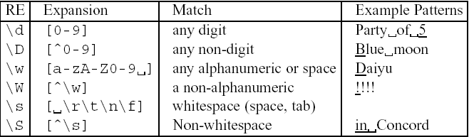
2.1 Regular Expressions
Advanced Operators
Aliases for common sets of characters
Regular Expressions and Automata

Slide 13
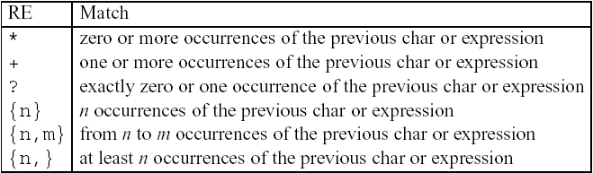
2.1 Regular Expressions
Advanced Operators
Regular expression operators for counting
Regular Expressions and Automata

Slide 14
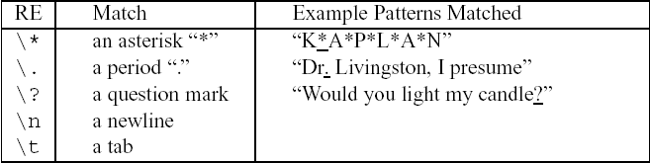
2.1 Regular Expressions
Advanced Operators
Some characters that need to be backslashed
Regular Expressions and Automata

Slide 15
2.1 Regular Expressions
Regular Expression Substitution, Memory, and ELIZA
s/regexp1/regexp2/
E.g. s/colour/color/
s/red/yellow/
E.g. the 35 boxes → the <35> boxes
I like the red color → I like the ‘red’ color
??
s/(red)/’\1’/
s/([0-9]+)/<\1>/
Regular Expressions and Automata

Slide 16
Regular Expressions-Memory
The following pattern matches “The bigger they were, the bigger they will be”, not “The bigger they were, the faster they will be”
/the (.*)er they were, the\1er they will be/
/The (Indians) are good. The \1 are always good/
The following pattern matches “The bigger they were, the bigger they were”, not “The bigger they were, the bigger they will be”
/the (.*)er they (.*), the\1er they \2/
registers
Regular Expressions and Automata
Regular Expressions and Automata

Slide 17
2.1 Regular Expressions
Regular Expressions Substitution, Memory, and ELIZA
Eliza worked by having a cascade of regular expression substitutions that each match some part of the input lines and changed them
  my → YOUR, I’m → YOU ARE …
s/.* YOU ARE (depressed|sad) .*/I AM SORRY TO HEAR YOU ARE \1/
s/.* YOU ARE (depressed|sad) .*/WHY DO YOU THINK YOU ARE \1/
s/.* all .*/IN WHAT WAY/
s/.* always .*/CAN YOU THINK OF A SPECIFIC EXAMPLE/
User₁: Men are all alike.
ELIZA₁: IN WHAT WAY
User₂: They’re always bugging us about something or other.
ELIZA₂: CAN YOU THINK OF A SPECIFIC EXAMPLE
User₃: Well, my boyfriend made me come here.
ELIZA₃: YOUR BOYBRIEND MADE YOU COME HERE
User₄: He says I’m depressed much of the time.
ELIZA₄: I AM SORRY TO HEAR YOU ARE DEPRESSED
Regular Expressions and Automata

Slide 18
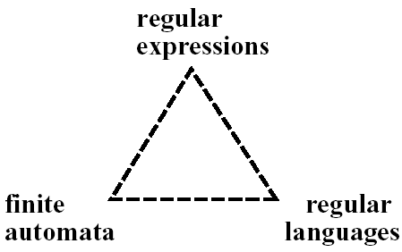
2.2 Finite-State Automata
An RE is one way of describing a FSA.
An RE is one way of characterizing a particular kind of formal language called a regular language.
Regular Expressions and Automata

Slide 19
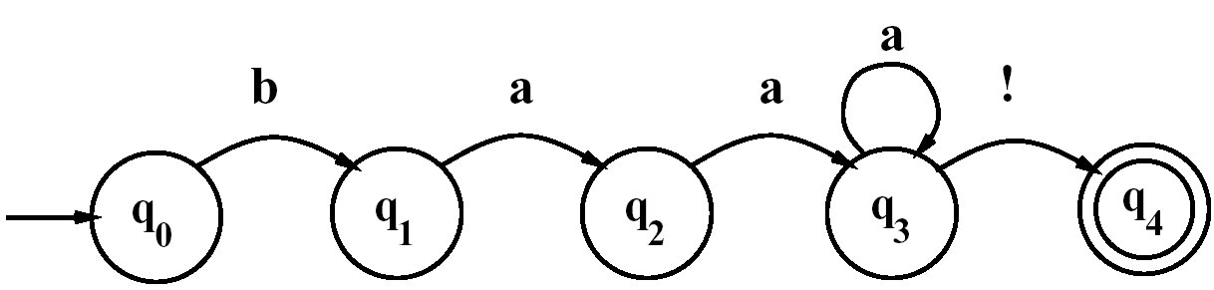
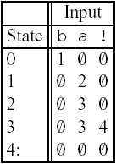
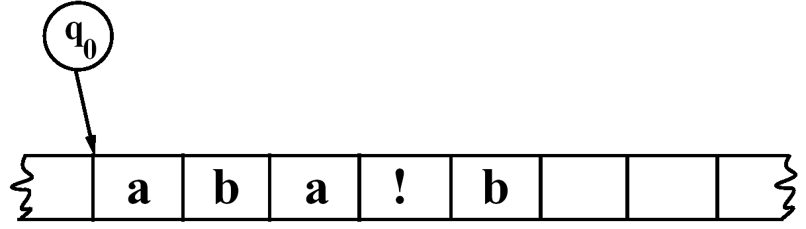
2.2 Finite-State Automata
Using an FSA to Recognize Sheeptalk
/baa+!/
The transition-state table
A tape with cells
Automaton (finite automaton, finite-state automaton (FSA))
State, start state, final state (accepting state)
Regular Expressions and Automata

Slide 20
2.2 Finite-State Automata
Using an FSA to Recognize Sheeptalk
A finite automaton is formally defined by the following five parameters:
  Q: a finite set of N states q₀, q₁, …, q_{N}
  Σ: a finite input alphabet of symbols
  q₀: the start state
  F: the set of final states, F ⊆ Q
  δ(q,i): the transition function or transition matrix between states. Given a state q ∈ Q and input symbol i ∈ Σ, δ(q,i) returns a new state q’ ∈ Q. δ is thus a relation from Q × Σ to Q;
Regular Expressions and Automata

Slide 21
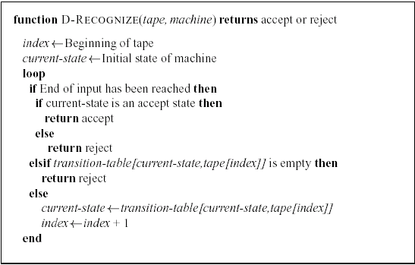
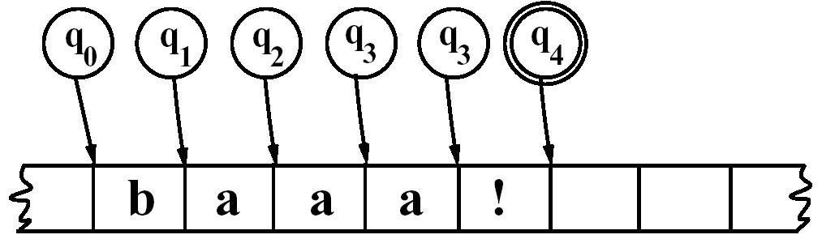
2.2 Finite-State Automata
Using an FSA to Recognize Sheeptalk
An algorithm for deterministic recognition of FSAs.
Regular Expressions and Automata

Slide 22
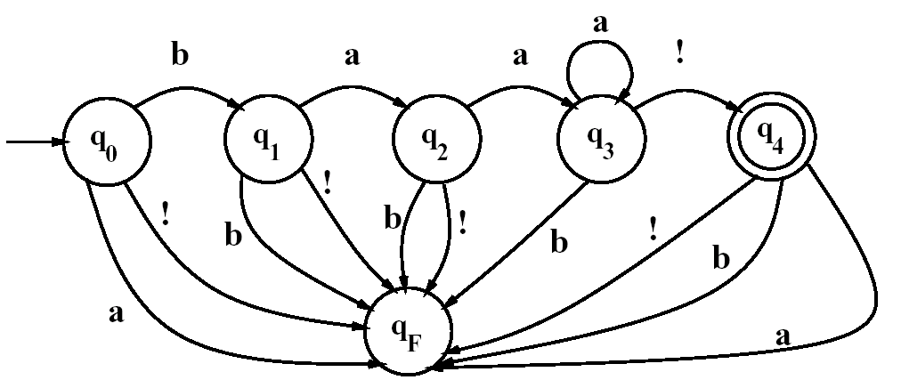
2.2 Finite-State Automata
Using an FSA to Recognize Sheeptalk
Adding a fail state
Regular Expressions and Automata

Slide 23
2.2 Finite-State Automata
Formal Languages
Key concept #1: Formal Language: A model which can both generate and recognize all and only the strings of a formal language acts as a definition of the formal language.
A formal language is a set of strings, each string composed of symbols from a finite symbol-set called an alphabet.
The usefulness of an automaton for defining a language is that it can express an infinite set in a closed form.
A formal language may bear no resemblance at all to a real language (natural language), but
  We often use a formal language to model part of a natural language, such as parts of the phonology, morphology, or syntax.
The term generative grammar is used in linguistics to mean a grammar of a formal language.
Regular Expressions and Automata

Slide 24
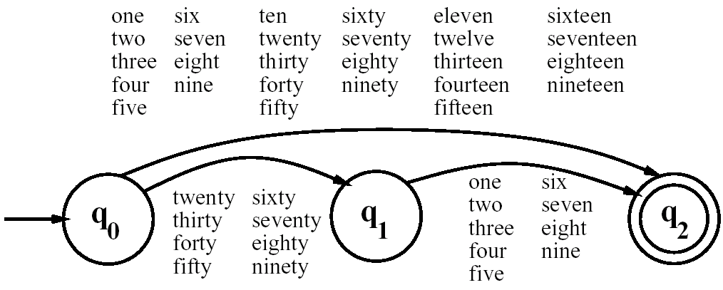
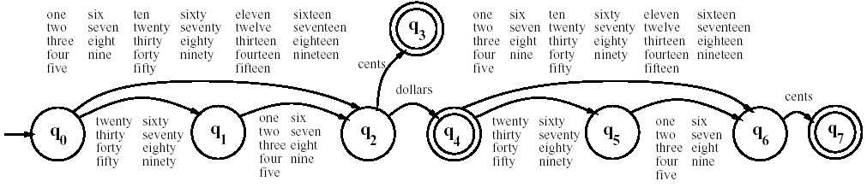
2.2 Finite-State Automata
Another Example
An FSA for the words of English numbers 1-99
FSA for the simple dollars and cents
Regular Expressions and Automata

Slide 25
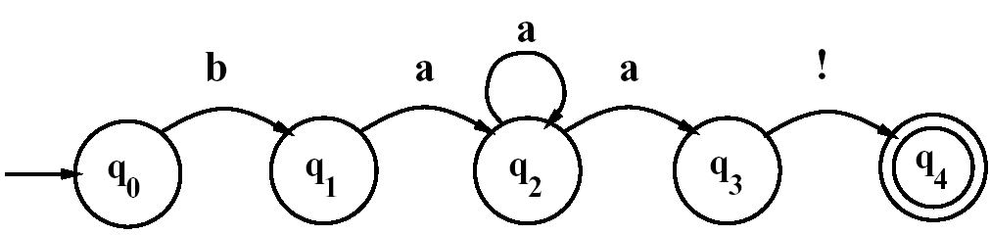
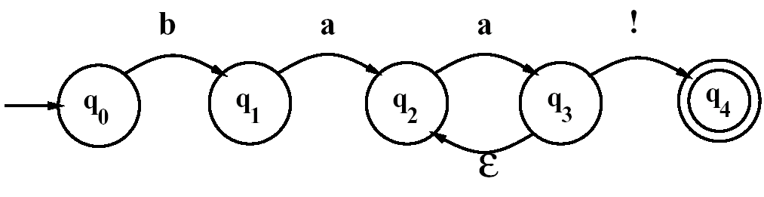
2.2 Finite-State Automata
Non-Deterministic FSAs
Regular Expressions and Automata

Slide 26
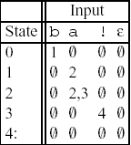
2.2 Finite-State Automata
Using an NFSA to Accept Strings
Solutions to the problem of multiple choices in an NFSA
  Backup
  Look-ahead
  Parallelism
Regular Expressions and Automata

Slide 27
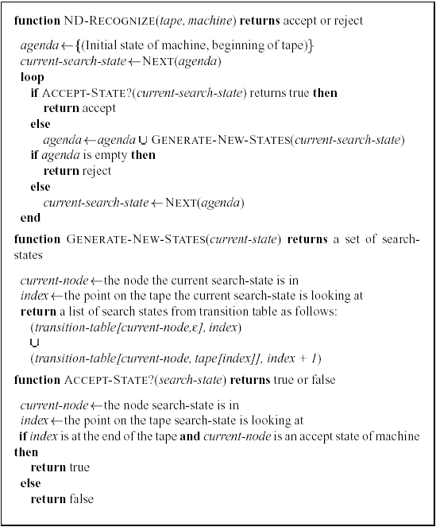
2.2 Finite-State Automata
Using an NFSA to Accept Strings
Regular Expressions and Automata

Slide 28
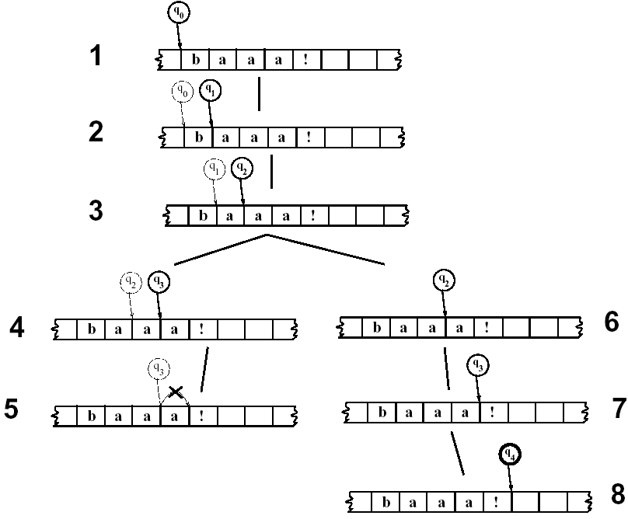
2.2 Finite-State Automata
Using an NFSA to Accept Strings
Regular Expressions and Automata

Slide 29
2.2 Finite-State Automata
Recognition as Search
Algorithms such as ND-RECOGNIZE are known as state-space search
Depth-first search or Last In First Out (LIFO) strategy
Breadth-first search or First In First Out (FIFO) strategy
More complex search techniques such as dynamic programming or A*
Regular Expressions and Automata

Slide 30
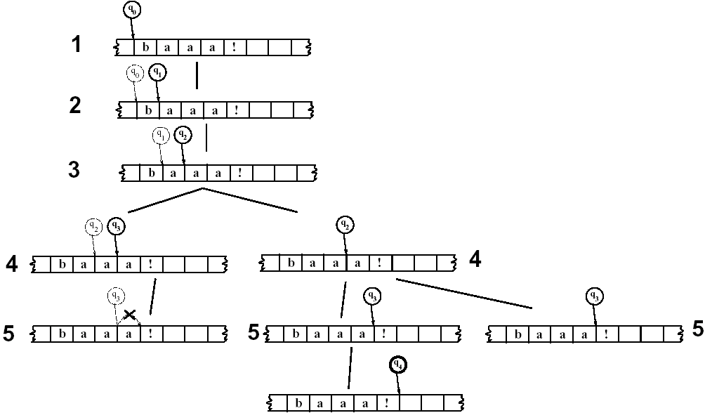
2.2 Finite-State Automata
Recognition as Search
A breadth-first trace of FSA #1 on some sheeptalk
Regular Expressions and Automata

Slide 31
2.3 Regular Languages and FSAs
The class of languages that are definable by regular expressions is exactly the same as the class of languages that are characterizable by FSA (D or ND).
  These languages are called regular languages.
The regular languages over Σ is formally defined as:
  φ is an RL
  ∀a ∈ Σ, {a} is an RL
  If L₁ and L₂ are RLs, then so are:
    L₁⋅L₂ ={xy| x ∈ L₁ and y ∈ L₂}, the concatenation of L₁ and L₂
    L₁∪L₂, the union of L₁ and L₂
    L₁*, the Kleene closure of L₁
Regular Expressions and Automata

Slide 32
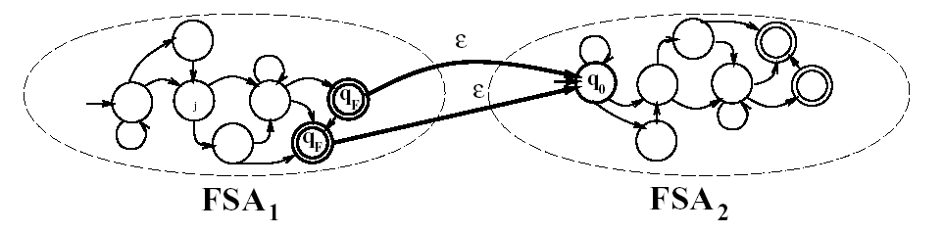
2.3 Regular Languages and FSAs
The concatenation of two FSAs
Regular Expressions and Automata

Slide 33
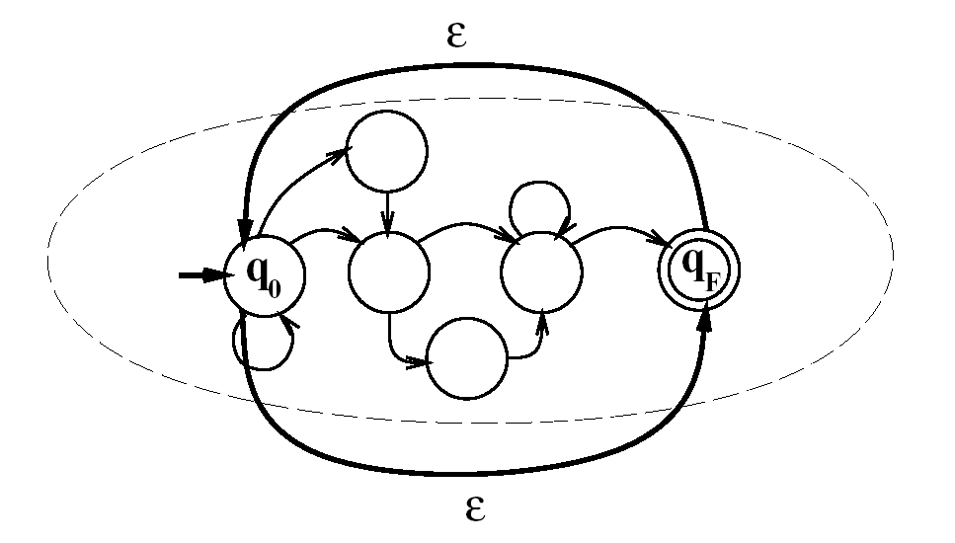
2.3 Regular Languages and FSAs
The closure (Kleene *) of an FSAs
Regular Expressions and Automata

Slide 34
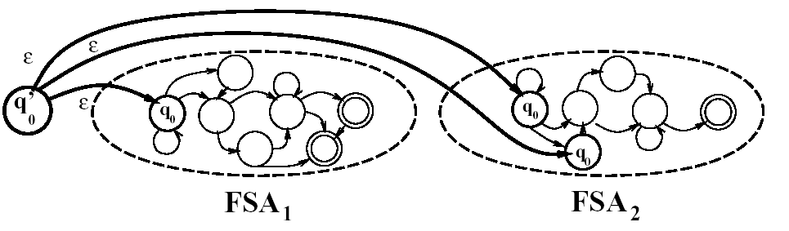
2.3 Regular Languages and FSAs
The union (|) of two FSAs
Regular Expressions and Automata

